Slide 1
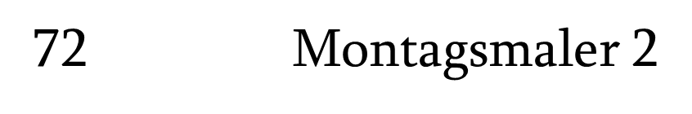

Muad, Han, Xia, John

Slide 2



01
index
02
03
contents

Slide 3
week 1
Basis GUI und simples neuronales Netzwerk
Anfangs hatten wir mehrere GUI Vorschläge, aber haben uns letztendlich für Muads GUI entschieden.
Man kann mit dem GUI ein Bild zeichnen, als Imagines Speichern und es in einem Array umwandeln .
In der dieser Woche haben wir das GUI gemacht.
Außerdem haben wir uns alle zu neuronale Netzwerke und deep learning informiert.

Slide 4
week 2
GUI mit Zeichenflache, neuronales Netzwerk mit linearer Klassifizierung
-über Perzeptronen informiert
-klassifizierung backward/forward propagation entschieden
-wir orientieren uns dabei an übung 2 & 3
-gui erweierten über überarbeiten
Weixia, John: basic mathematics matrix operations
Muad: GUI ,datareader
Han: forward propagation

Slide 5
week 3
Neuronales Netzwerk mit nonlinearer Klassifizierung
in dieser Woche haben John und Xia ein Trainingsset erstellt und den Datenreader überarbeitet.
Muad und Han haben Backwardpropagation und Runterskalierung gemacht.
Muad, Han, Weixia, John.

Slide 6
week 4
GUI mit neuronalem Netzwerk verbinden
In dieser woche haben wir:
-weights read/write
-bias read/write
-backwardpropagation
-training mit Datareader verbinden
-runterskalieren

Slide 7
week 5
Polish
JavaDoc Kommentare geschrieben,
das GUI mit dem NeuralNetwork verbunden
- und die Präsentation erstellt
In dieser woche haben wir:
In dieser Woche haben wir die Bugs im NeuralNetwork gefixt,.

Slide 8


The first problem is that the image is converted into binary encoding, the first time I made a mistake, because I turned the file itself into binary, not the content of the image
If the pixel of the entire picture is used as input, the amount of data is too large, so the suggestion of nils is runter skalierung, make the picture smaller
Because it is not clear how much the picture can be reduced, so have to check the information
 

Slide 9
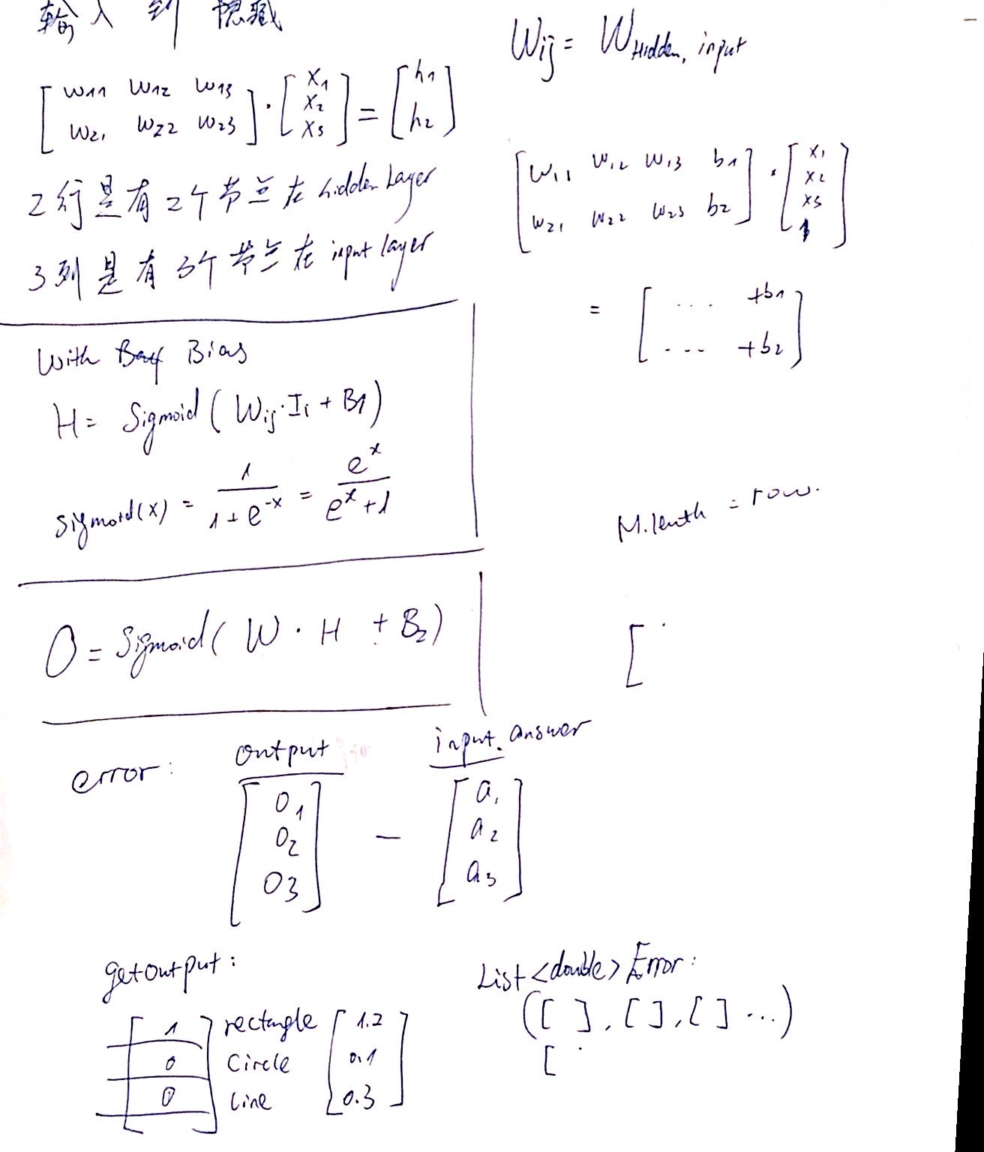

only one hidden layer may be not enough
At first, there was a debate about how many hidden layers, the confusion is that it is one or two hidden layers
but luckily later we find that, with one hidden layer we could also get a good result

Slide 10
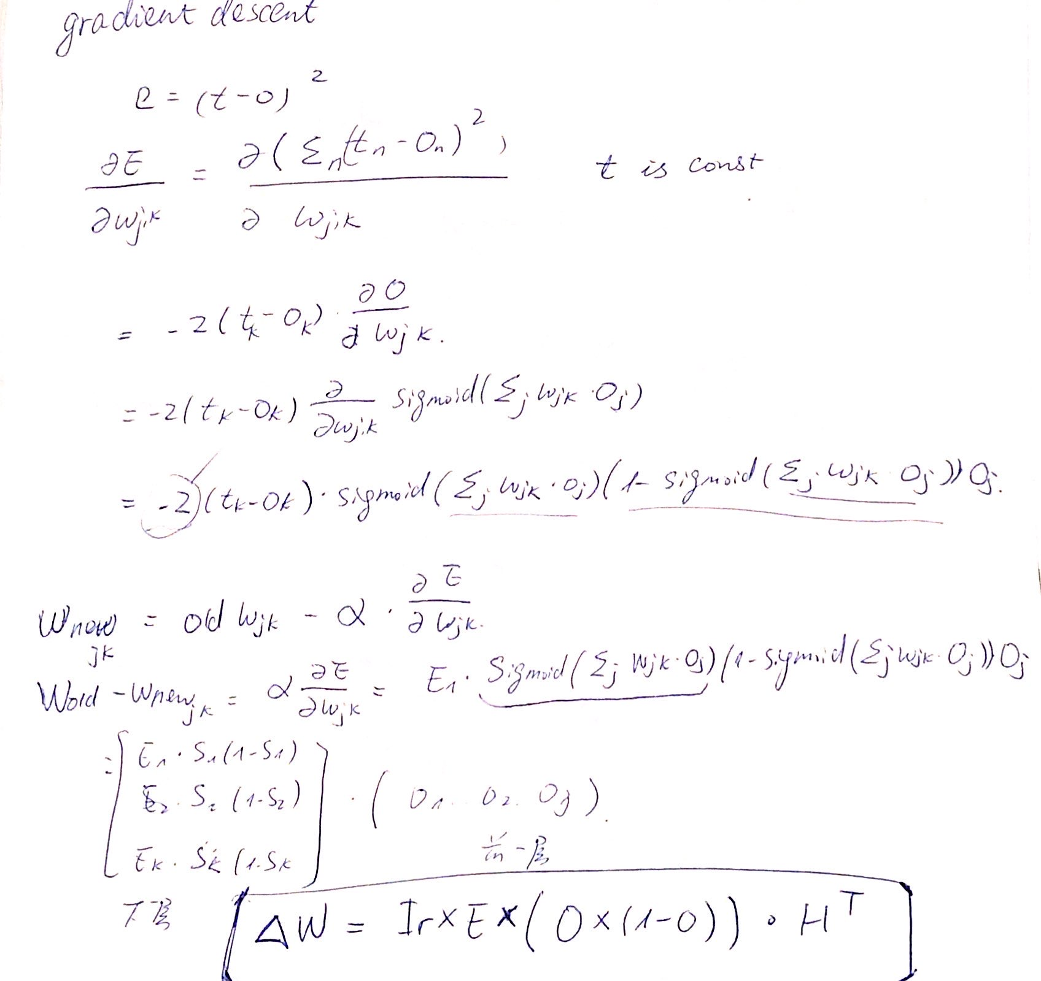
The mathematical problem, the first theoretical formula, was organized into two papers
标题文本预设
Whether you’re a graphic designer, an entrepreneur, a web designer or a developer, this post will give you some great ideas for learning new skills. We’ll go through some great courses and tutorials on graphic design, web design, coding, and more.

Slide 11

Model
car
…
Image Processing
fish
heart
house
smile
x
input[]
pixels
output[]
name
Image 450*450
Data Type : Data

Slide 12

Image Processing (step 1)
Convert to binary image
Image 450*450
Binary image

Slide 13

Image Processing (step 2&3)
Cut out the white side
Scale to size 50*50
Binary image

Slide 14



Research: Scale, to find the best size
30*30
40*40
50*50
50*50 contains most informations

Slide 15
Image Processing (step 4&5)
00000000111111000000000000000000000000000000000000
00000111111111110000000000000000000000000000000000
00011100000000011100000000000000000000111000000000
00110000000000001110000000000000001111111111000000
00100000000000000011000000000000111110000011110000
01100000000000000001100000000011110000000000111000
01000000000000000000110000001110000000000000001110
11000000000000000000011000011000000000000000000110
10000000000000000000011000110000000000000000000011
10000000000000000000001101100000000000000000000001
10000000000000000000000111000000000000000000000001
10000000000000000000000011000000000000000000000001
10000000000000000000000000000000000000000000000001
10000000000000000000000000000000000000000000000001
10000000000000000000000000000000000000000000000001
11000000000000000000000000000000000000000000000001
01000000000000000000000000000000000000000000000011
01000000000000000000000000000000000000000000000010
01100000000000000000000000000000000000000000000010
00100000000000000000000000000000000000000000000010
00100000000000000000000000000000000000000000000110
00110000000000000000000000000000000000000000000100
00010000000000000000000000000000000000000000001100
00011000000000000000000000000000000000000000001000
00001100000000000000000000000000000000000000001000
00001100000000000000000000000000000000000000011000
00000110000000000000000000000000000000000000010000
00000010000000000000000000000000000000000000010000
00000011000000000000000000000000000000000000110000
00000001100000000000000000000000000000000000100000
00000000100000000000000000000000000000000001100000
00000000010000000000000000000000000000000011000000
00000000011000000000000000000000000000000010000000
00000000001100000000000000000000000000000010000000
00000000000110000000000000000000000000000110000000
00000000000011000000000000000000000000001100000000
00000000000001100000000000000000000000001000000000
00000000000001110000000000000000000000011000000000
00000000000000110000000000000000000000110000000000
00000000000000011000000000000000000000100000000000
00000000000000001100000000000000000001100000000000
00000000000000000110000000000000000011000000000000
00000000000000000011000000000000000110000000000000
00000000000000000001000000000000001100000000000000
00000000000000000000100000000000111000000000000000
00000000000000000000110000000001110000000000000000
00000000000000000000011000000011000000000000000000
00000000000000000000001000011110000000000000000000
00000000000000000000000111110000000000000000000000
00000000000000000000000111000000000000000000000000
0000000011111100000000000000000000000000000000000000000111111111110000000000000000000000000000000000
2D Array[50][50]
0: white
1: black
1D Array[2500]

Slide 16
Mathematischer Hintergrund
Input Layer
Hidden Layer 1
Hidden Layer 2
Output Layer
1D Array[2500]
…
…
…
1253 = (2500 + 6) / 2
2500
1253
1253
6
(actually the model with only 1 hidden layer was decided)

Slide 17
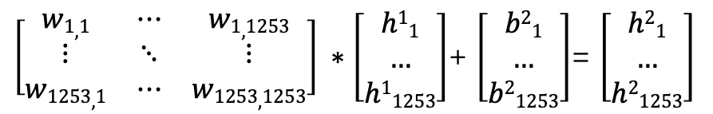
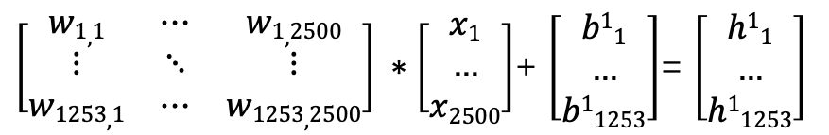
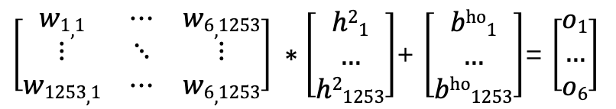
Mathematischer Hintergrund: Forward
Input Layer
Hidden Layer 1
Hidden Layer 2
Output Layer
2500
1253
1253
6
W^{ih}_{1253,2500} * X^{in}₂₅₀₀ + B^{ih}₁₂₅₃= H¹
W^{hh}_{1253,1253} * H¹ + B^{hh}₁₂₅₃= H²
W^{ho}_{6,1253} * H² + B^{ho}₆= O_{6,1}
$\left[\begin{matrix}w1,1 & ⋯ & w1,2500 \\ ⋮ & ⋱ & ⋮ \\ w1253,1 & ⋯ & w1253,2500\end{matrix}\right] ∗\left[\begin{matrix}x1 \\ … \\ x2500\end{matrix}\right]$+ $\left[\begin{matrix}b11 \\ … \\ b11253\end{matrix}\right]$= $\left[\begin{matrix}h11 \\ … \\ h11253\end{matrix}\right]$
weight matrix
input
bias
hidden 1
$\left[\begin{matrix}w1,1 & ⋯ & w1,1253 \\ ⋮ & ⋱ & ⋮ \\ w1253,1 & ⋯ & w1253,1253\end{matrix}\right] ∗\left[\begin{matrix}h11 \\ … \\ h11253\end{matrix}\right]$+ $\left[\begin{matrix}b21 \\ … \\ b21253\end{matrix}\right]$= $\left[\begin{matrix}h21 \\ … \\ h21253\end{matrix}\right]$
weight matrix
hidden1
bias
hidden 2
$\left[\begin{matrix}w1,1 & ⋯ & w6,1253 \\ ⋮ & ⋱ & ⋮ \\ w1253,1 & ⋯ & w6,1253\end{matrix}\right] ∗\left[\begin{matrix}h21 \\ … \\ h21253\end{matrix}\right]$+ $\left[\begin{matrix}bho1 \\ … \\ bho1253\end{matrix}\right]$= $\left[\begin{matrix}o1 \\ … \\ o6\end{matrix}\right]$
weight matrix
hidden 2
bias
output

Slide 18
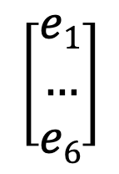
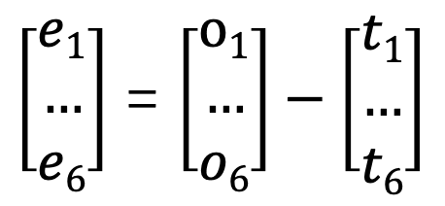

Mathematischer Hintergrund: Error
Hidden Layer 2
Output Layer
Error
1253
6
6
$\left[\begin{matrix}e1 \\ … \\ e6\end{matrix}\right]$ = $\left[\begin{matrix}o1 \\ … \\ o6\end{matrix}\right]−\left[\begin{matrix}t1 \\ … \\ t6\end{matrix}\right]$
Error
Output
Target
Hidden Layer 2
Output Layer
Error
1253
6
6
$$\left[\begin{matrix}e1 \\ … \\ e6\end{matrix}\right]$$
$$Ehidden=WTHO+Eoutput$$
Error

Slide 19


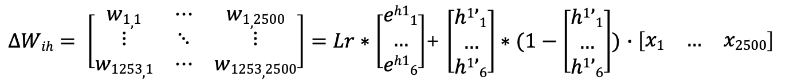
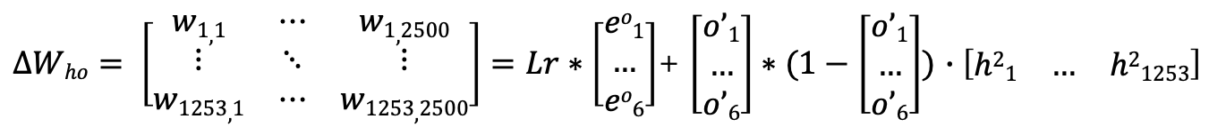



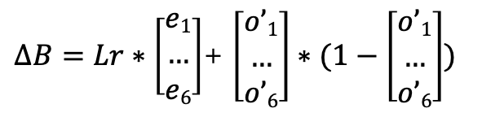
Mathematischer Hintergrund: Backword
Input Layer
Hidden Layer 1
Hidden Layer 2
Output Layer
2500
1253
1253
6
Calculate Error donation:
$$Ehidden=WTHO+Eoutput$$
Lr: learning rate
$$O’= sigmoid(O)$$
Calculate Weight Difference:
$$∆W=Lr ∗E ∗(O’∗(1−O’))∙HT$$
$∆Who= \left[\begin{matrix}w1,1 & ⋯ & w1,2500 \\ ⋮ & ⋱ & ⋮ \\ w1253,1 & ⋯ & w1253,2500\end{matrix}\right]=Lr∗\left[\begin{matrix}eo1 \\ … \\ eo6\end{matrix}\right]$+ $\left[\begin{matrix}o’1 \\ … \\ o’6\end{matrix}\right]∗(1−\left[\begin{matrix}o’1 \\ … \\ o’6\end{matrix}\right])$ $∙\left[\begin{matrix}h21 & … & h21253\end{matrix}\right]$
$∆B=Lr∗\left[\begin{matrix}e1 \\ … \\ e6\end{matrix}\right]$+ $\left[\begin{matrix}o’1 \\ … \\ o’6\end{matrix}\right]∗(1−\left[\begin{matrix}o’1 \\ … \\ o’6\end{matrix}\right])$
$∆Whh= \left[\begin{matrix}w1,1 & ⋯ & w1,2500 \\ ⋮ & ⋱ & ⋮ \\ w1253,1 & ⋯ & w1253,2500\end{matrix}\right]=Lr∗\left[\begin{matrix}eh21 \\ … \\ eh26\end{matrix}\right]$+ $\left[\begin{matrix}h2’1 \\ … \\ h2’6\end{matrix}\right]∗(1−\left[\begin{matrix}h2’1 \\ … \\ h2’6\end{matrix}\right])$ $∙\left[\begin{matrix}h11 & … & h11253\end{matrix}\right]$
Update Bias:
$$B=B+∆B$$
$∆Wih= \left[\begin{matrix}w1,1 & ⋯ & w1,2500 \\ ⋮ & ⋱ & ⋮ \\ w1253,1 & ⋯ & w1253,2500\end{matrix}\right]=Lr∗\left[\begin{matrix}eh11 \\ … \\ eh16\end{matrix}\right]$+ $\left[\begin{matrix}h1’1 \\ … \\ h1’6\end{matrix}\right]∗(1−\left[\begin{matrix}h1’1 \\ … \\ h1’6\end{matrix}\right])$ $∙\left[\begin{matrix}x1 & … & x2500\end{matrix}\right]$
Update Weight:
$$W=W+∆W$$

Slide 20
Structure
Class | Describe
Data | a data structure
Data Reader | operations with data and images, image processing
GUI | Functions to pain with convey and pen
Matrix | mathematic functions
Neural Network | The neural network, with input layer, output layer, hidden layers, error, forward and backword propergation Provides functions, like train and test
Traing Dataset
Weight
Weight
Training
Using
GUI
DataReader
Neural Network
GUI
DataReader
Neural Network
User
Data
Matrix
Data
Matrix

